Slide 1


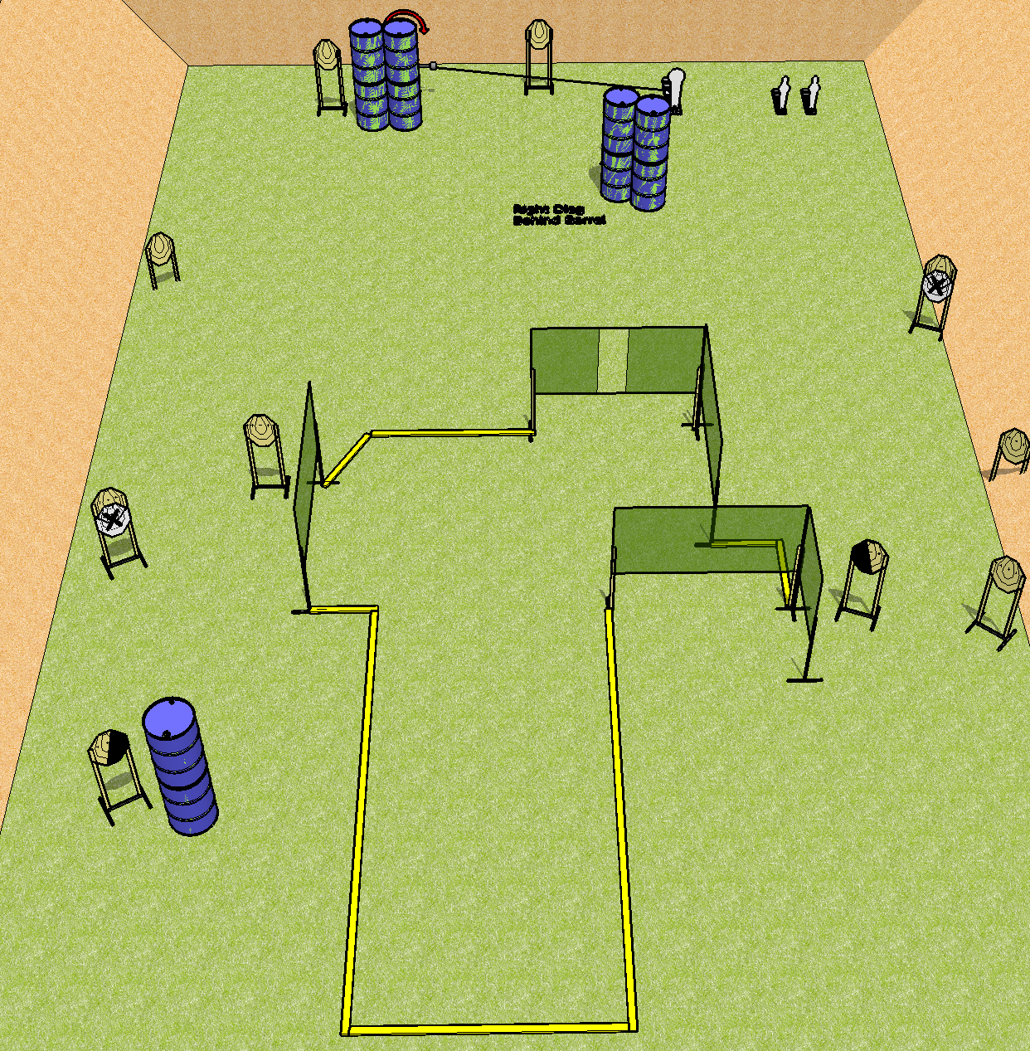
 | Dothan Gun Club – USPSA Match Go Down Range Course Designer : Drew Coleman Bay: C1
Round Count 27 rounds 12 IPSC 1 colt popper, 2 minis
Equipment List 8 wall feet Swinger + activator 2 right diag, 1 left diag 11 targets (9 + 2 NS)

Slide 2
Go Down Range
Written Stage Briefing
Scoring: Comstock Rounds: 27
Targets: 12 IPSC, 3 steel
Handgun start position: anywhere inside the shooting area, wrists below belt. Handgun is loaded and holstered.
PCC start position: anywhere inside the shooting area, stock on belt. Loaded carbine is held with both hands, safety on.
Stage Procedure: on the audible start signal, engage targets as they become available from within the shooting area. The swinger is activated by P1.

